Slide 1

https://www.uni-goettingen.de/en/48115.html
UNPLAB-QuGen_Ch-9[Decomp-GenV II]
We decompose and recompose the genetic variance based on the statistical model (you know: with α₁, α₂, δ₁₁, δ₁₂, δ₂₂; et cetera).
1

Slide 2
Sequential Number: #43
UNPLAB-QuGen_Ch-9[Decomp-GenV II]
Unless I explicitly state otherwise, images and cartoons are created using ChatGPT.
You may use this material free of charge under the terms of the CC BY license. This requires that you provide appropriate attribution to the author:
W. Link, University of Goettingen, Germany.
In a few cases, individual images, photographs, or similar material may be subject to a more restrictive Creative Commons license. Where this applies, it is explicitly indicated, and you must comply with the stated license terms for those items.
Please check the license information carefully before reuse. Responsibility for complying with the applicable license terms rests entirely with you.
2

Slide 3
You already know 42 chapters of UNPLAB
Keywords of this chapter:
Diversity vs. Variance; Normal Distribution and Variance; More than one trait to breed for; Qualitative vs. quantitative variation aka monogenic vs. polygenic variance; Impact of allele frequencies on variance, aka impact of selection of variance. You have seen the transition from monogenic to polygenic Segregation and Variance. The parameters of the Metric F∞ Model, mainly the additive effect ‘a’ and the dominance effect ‘d’. The parameters of the Statistical Model, mainly Additive and Dominance Variance.
Algebra as introduced in this chapter: None; we use the Algebra of QuGen_Ch-8 to draw enlightening diagrams.
3

Slide 4
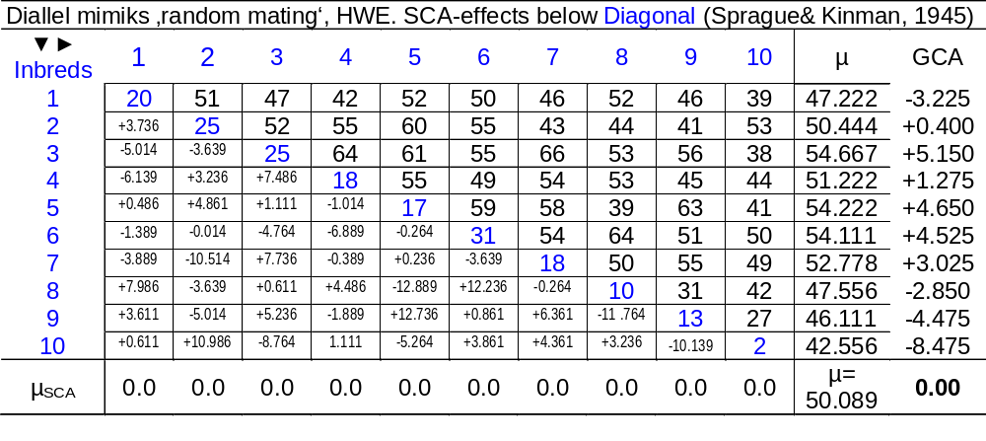
Insertion, slide-in: You may go back and have a look again on the terms GCA, SCA UNPLAB-BrMeth_Ch-3[GCA I] and UNPLAB-BrMeth_Ch-4[GCA II]
4

Slide 5
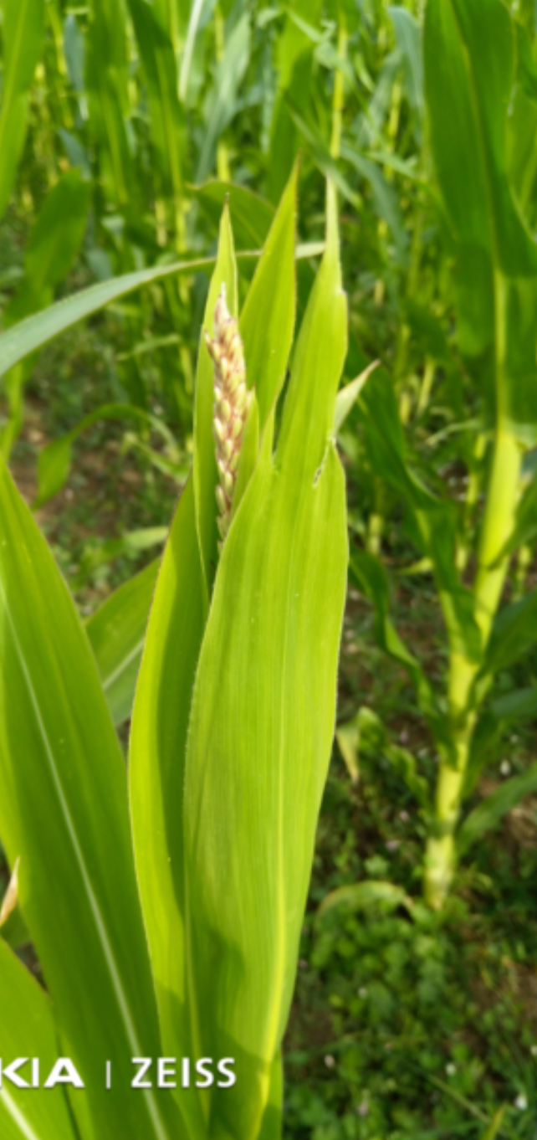
Breeding Values and Dominance Deviations are Quantitative Genetics parameters, based on model and locus-wise assumptions. For instance, for σ²_{G} = σ²_{A} + σ²_{D} we need to assume: ‚HWE; zero epistasis among loci‘ ...
… whereas GCA and SCA is ‚phenotype‘: Data is from trait assessment, including issues such as LD, epistasis, et cetera. A single F1 entry holds the GCA-effect from mother line plus GCA-effect from father line. These two GCA-effects jointly represent the Breeding Value of such F1 (simplified model).
The BV of an inbred lines is, hence 2∙GCA of such line.
For a HWE population, we write: σ²_{G} = σ²_{A} + σ²_{D}= 2σ²_{GCA} + σ²_{SCA}.
Obviously, Diallel data is used to estimate σ²_{A}, σ²_{D} of traits
(equating σ²_{A} = 2σ²_{GCA}; σ²_{D} = σ²_{SCA}; hm ... here σ²_{A} = 2σ²_{GCA}; if we take non-inbreds (F=0) as parents of the Diallel cross instead of pure lines, then their σ²_{GCA} is smaller and hence in that case we must equate σ²_{A} = 4σ²_{GCA} ... see later).
Watch out, we have 3 terms, do not mix it up:
Additive Effect A. Breeding Value BV. GCA Effect.
Given pertinent assumptions, we have σ²_{A} = σ²_{BV} = 2σ²_{GCA}
© WL
5

Slide 6
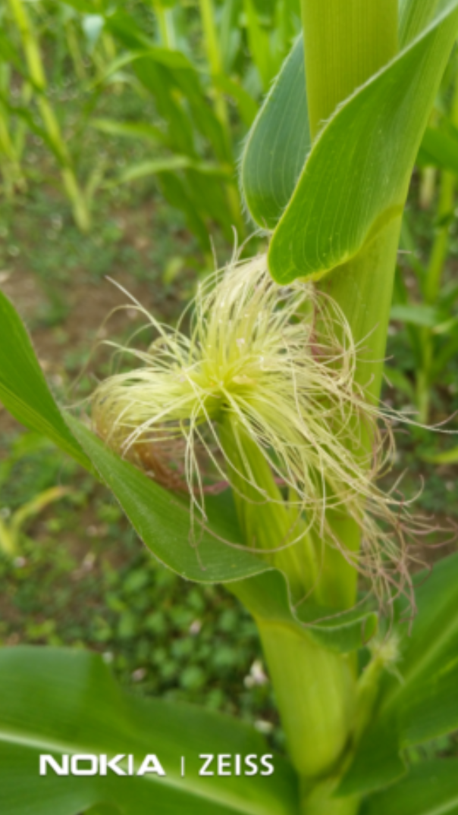
Breeding Values and Dominance Deviations are Quantitative Genetics parameters, based on model and locus-wise assumptions. For instance, for σ²_{G} = σ²_{A} + σ²_{D} we need to assume: ‚HWE; zero epistasis among loci‘ ...
6
… whereas GCA and SCA is ‚phenotype‘: Data is from trait assessment, including issues such as LD, epistasis, et cetera. A single F1 entry holds the GCA-effect from mother line plus GCA-effect from father line. These two GCA-effects jointly represent the Breeding Value of such F1. The BV of an inbred line is, hence 2∙GCA of such line. For a HWE population, we write: σ²_{G} = σ²_{A} + σ²_{D}= 2σ²_{GCA} + σ²_{SCA}.
Obviously, Diallel data is used to estimate σ²_{A}, σ²_{D} of traits
(... equating σ²_{A} = 2σ²_{GCA}; σ²_{D} = σ²_{SCA}; hm ... here σ²_{A} = 2σ²_{GCA}. Wait if we took non-inbreds as parents of the Diallel cross instead of pure lines? σ²_{GCA} of non-inbreds is smaller and hence in that case we must equate σ²_{A} = 4σ²_{GCA} ... see later).
With σ²_{GCA}= 15.2 (bu/acre)² and σ²_{SCA}= 46.2 (bu/acre)² , we ‘conclude’ that our estimates are σ²_{A} = 30.4; σ²_{D} = 46.2 (bu/acre)² || additive variance equal to twice the estimated GCA variance ||. Ratio σ²_{D} / σ²_{A} = is unusually large here, ... hm ...
... the estimates of a and d, employed to play around with the Quantitative Genetics Algebra - these estimates are of course as well deduced from phenotypic data. In Quantitative Genetics, we can pretend LD=0, Epistasis=0, ... and deduce genotypic effects, values, variances accordingly. In contrast, GCA and SCA is ‘real-world’; we can not easily bring LD and epistasis and ... to zero in reality; and why should we?
© WL
© WL

Slide 7
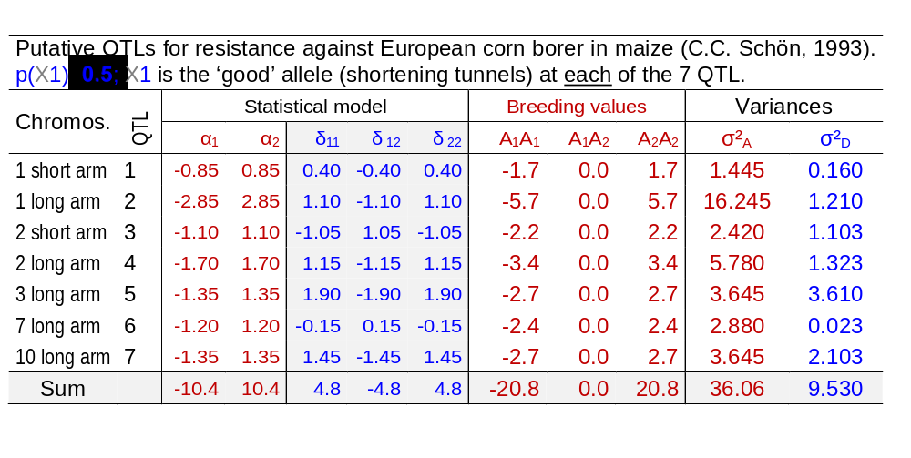
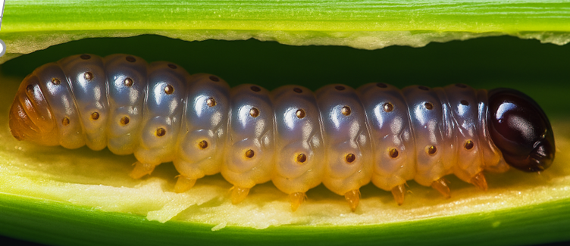
Back to the Maiszünsler-example. See the locus-wise and, across 7 loci, trait-wise σ²_{A} and σ²_{D} (HWE; p=q=0.5: remember, it was a bi-parental cross).
Europ. corn borer (Ostrinia nubilalis; Maiszünsler); caterpillar (Raupe)
Don‘t be shy. Just add up 36.06 plus 9.530 and come to a total of genetic variance (genotypic variance) σ²_{G} for this trait in this HWE-(well ... F2-) population of σ²_{G} = 45.590 cm² (σ_{G} = 6.752cm).
7

Slide 8
Schön, Lee, Melchinger, Guthrie, Woodman, 1993: Heredity 70: 648-659.
Tunnel length, absolute values (cm)
14
50.9cm
If we transferred the HWE population to full homozygosity (F=1), without changing allele frequency, we obtain this distribu-tion of genotypic values (so to say the un-selected total of all possible DH lines or RILs .... LD=0, anyway).
The most susceptible genotype then occurs with frequency of 0.5⁷ = 1 : 128 with tunnels 20.8cm longer than the mean (c=µ_{(F=1)}=50.9cm). The value 20.8cm is the sum of the additive effects of the 7 QTL. The least susceptible homozygous genotype has correspondingly tunnels 20.8cm shorter than mean. This is not the most resistant genotype, because two QTL have (favourable) d effects larger than their a effect.
36
48
60
72
12
Now:
Not HWE
but F=1
10
8
Number of individuals
σ_{G}=8.492
6
4
2
1
0
-24
-20
-16
-12
-8
-4
0
4
8
12
16
20
24
Tunnel length, G deviation from pop. µ
8

Slide 9
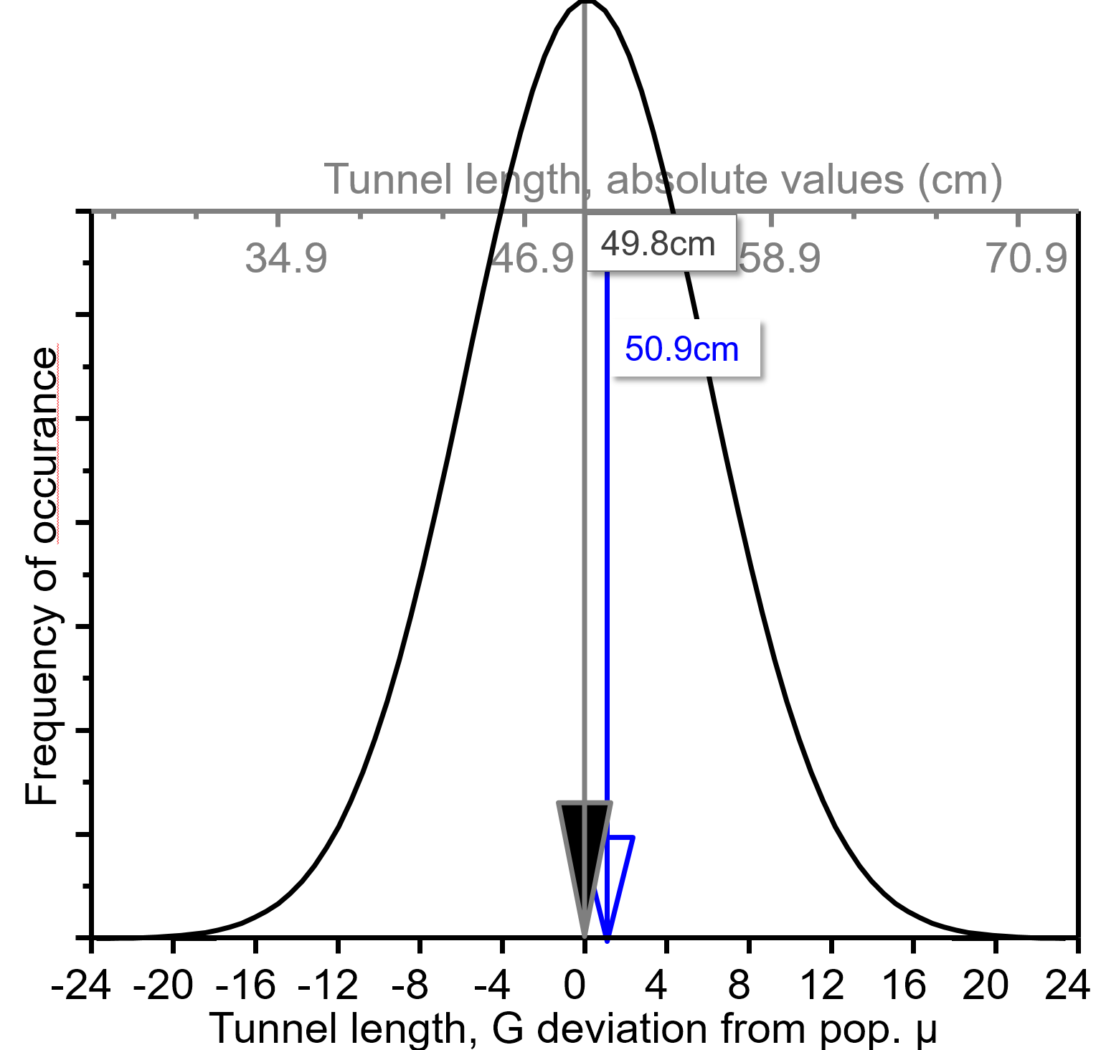
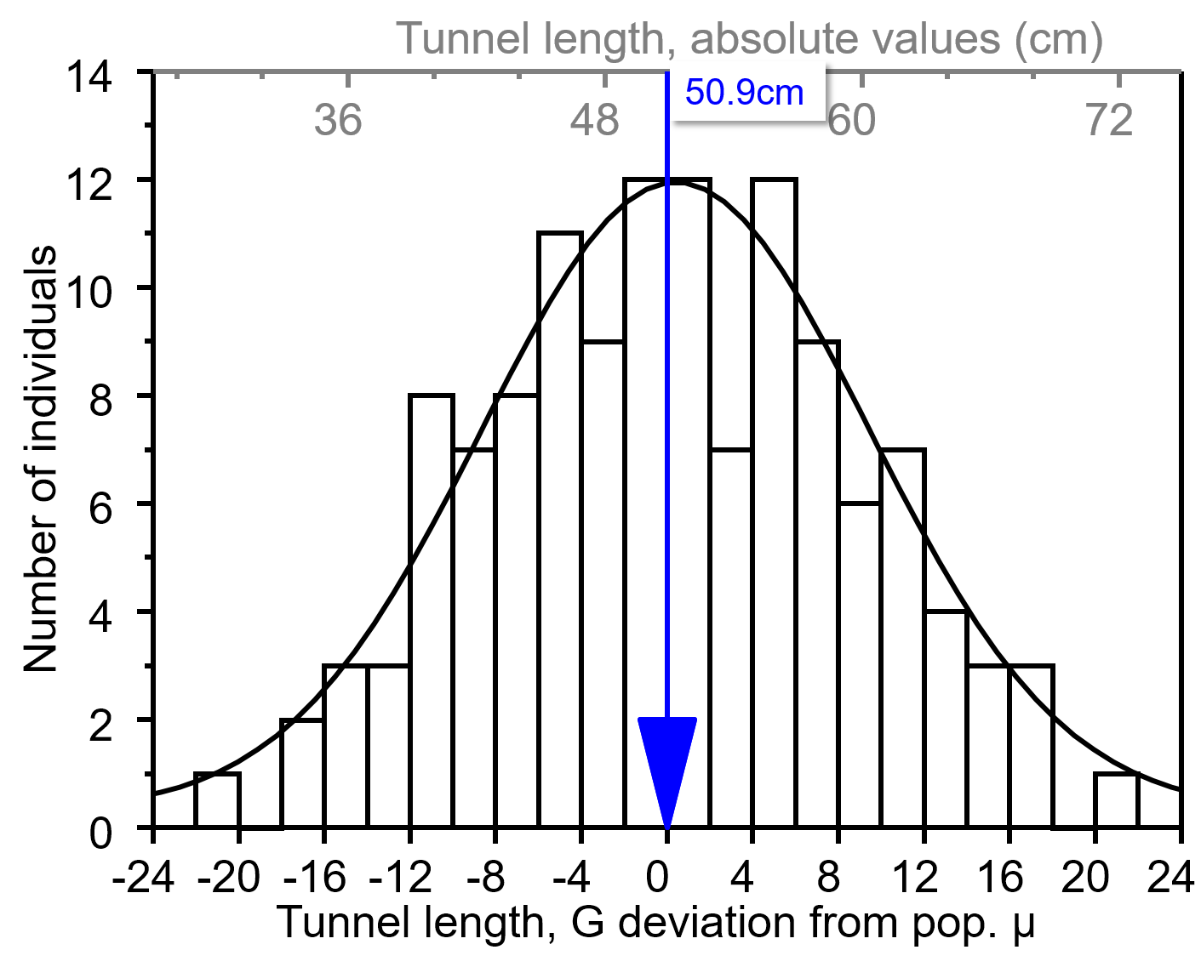
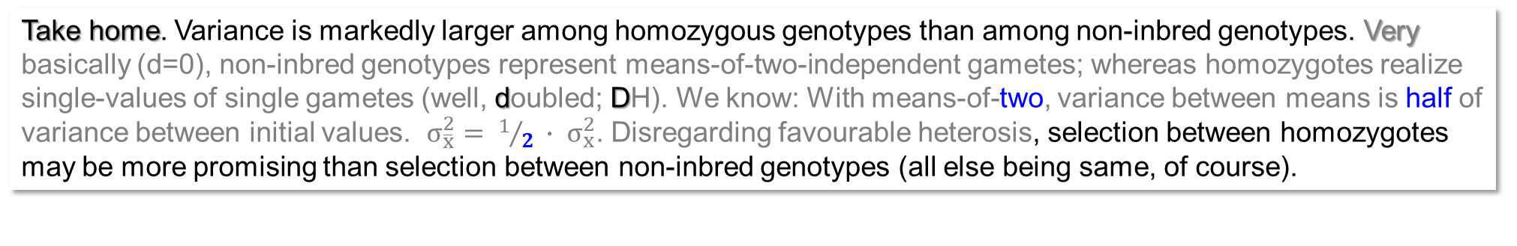
Schön et al. 1993. Compare mean and Genotypic Variation in case of homozygosity (left) and in case of HWE (right; non-inbred status of population). p=q=0.5 anyway.
‚Best‘
1:128
‚Best‘
1:4096
Population µ is 1.1cm shorter in HWE than at F=1: due to mostly favourable (shortening) domi-nance effects (favourable hetero-sis).
The most resistant genotype‘s tunnels are 50.9-22.1=28.8cm, it occurs in the HWE population. Yet, with a probability of only 0.25⁵∙0.5² = 1:4096 ... ... and, again, the most resistant homo-zygous one shows a genetic value of 50.9-20.8=30.1cm; with F=1 (left diagram), its probability of occurrence is 0.5⁷ = 1:128.
σ_{G}=8.492
σ_{G}=6.752
F=0
F=1
F=0
F=1
Take home. Variance is markedly larger among homozygous genotypes than among non-inbred genotypes. Very basically (d=0), non-inbred genotypes represent means-of-two-independent gametes; whereas homozygotes realize single-values of single gametes (well, doubled; DH). We know: With means-of-two, variance between means is half of variance between initial values. $σ_{\overline{x}}^{2}= 1/2 ∙ σ_{x}^{2}$. Disregarding favourable heterosis, selection between homozygotes may be more promising than selection between non-inbred genotypes (all else being same, of course).
9

Slide 10
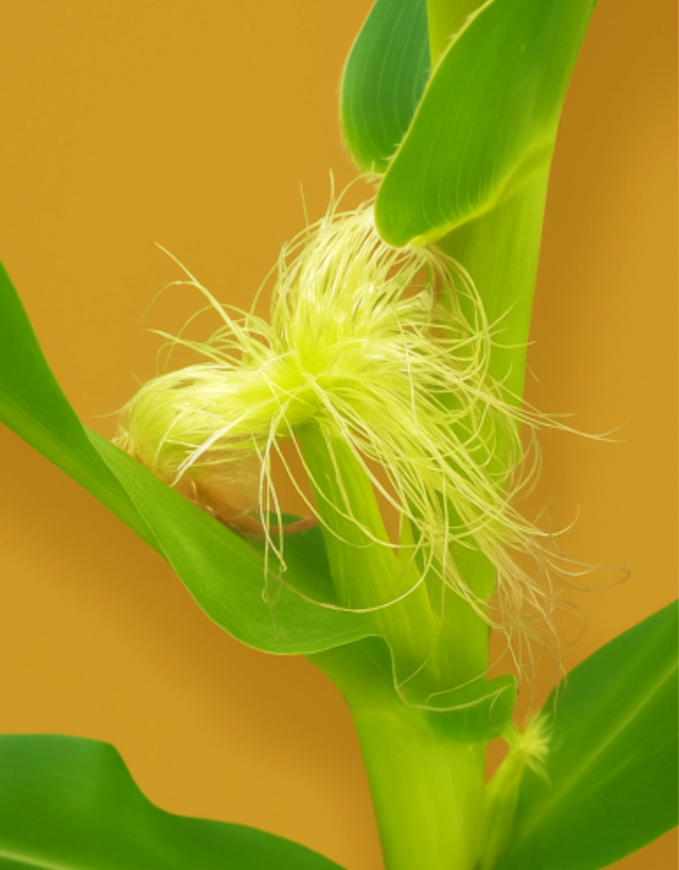
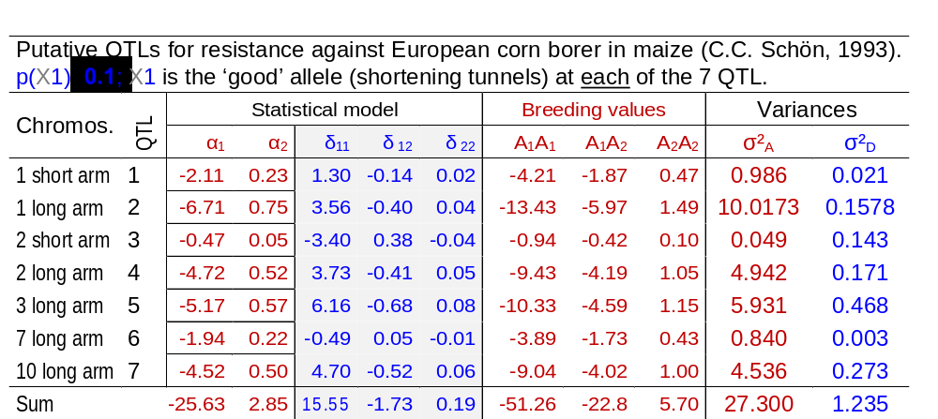
Still the Maiszünsler-example.
See the locus-wise and, across 7 loci i.e. trait-wise σ²_{A} and σ²_{D}; either with p=0.5 (top) or with p=0.1 (below).
The 7 QTL did not ‚explain‘ the entire genetic variance; yet, we just pretend for once.
To add up as we do here is naïve, for several reasons. One reason is the possibility of epis-tatic interactions. Simply adding may make sense if epistasis was zero.
There is more variance at p=0.5 than at p=0.1.
© W. Link, photo enhanced with AI.
Maize, frequently used example of
an outcrossing
crop with high heterosis.
10

Slide 11
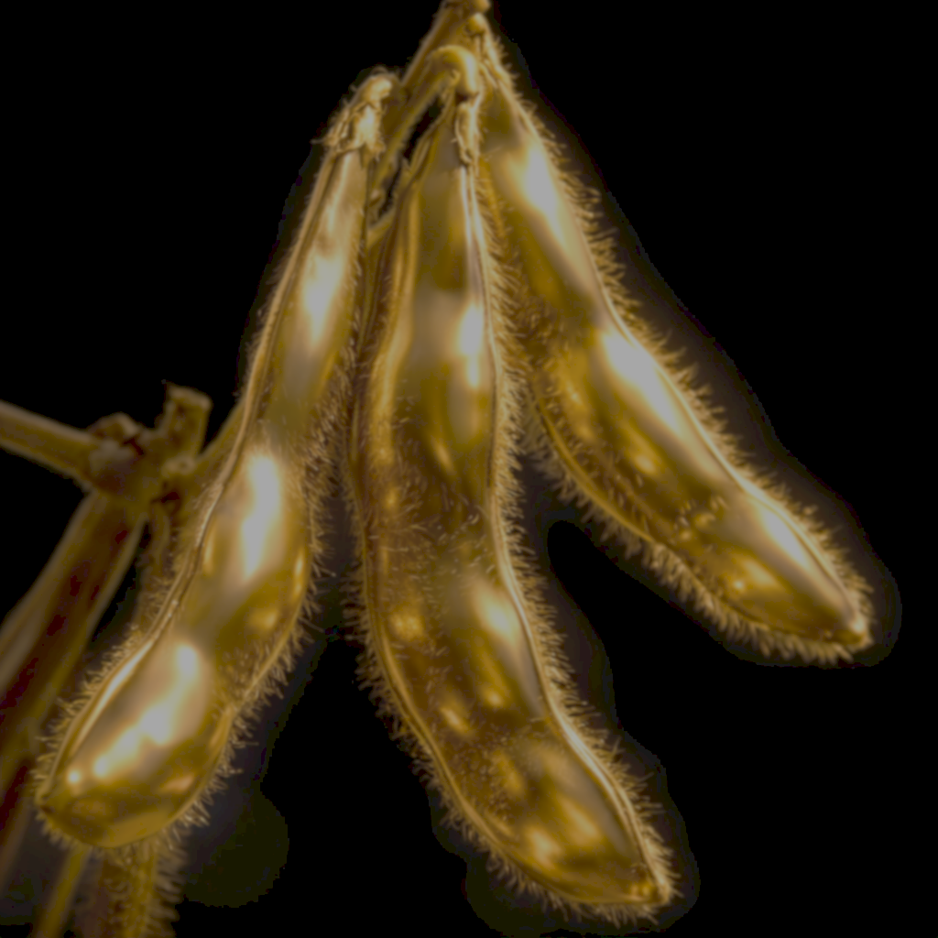
A comment and perspective that you have come to recognise as typical of my lectures and presentations.
p=q=0.5: Default outcome from bi-parental, Mendelian crosses, which is the every-day business of line breeders (soy breeder, barley breeders, ...). These colleagues may tend to think …
σ²_{A}=0.5 a² instead of
σ²_{A}=2pq[a-(p-q)d]²=2pq[α]²
and
σ²_{D}=0.25 d² instead of
σ²_{D}=(2pqd)².
Some find it even difficult to appreciate the difference between e.g. the allele-frequency independent parameter a (metric additive effect) and the statistical parameter α (average effect of allele substitution). Of course we can see why: α=α₁- α₂ = [a-(p-q)d]; with either p=q=0.5 or with d=0 (or both) you find
α=a; α₁=qa; α₂=-pa). … well …
Left, maize, an outcrossing species, right, soy, a self-fertilizing species.
11

Slide 12
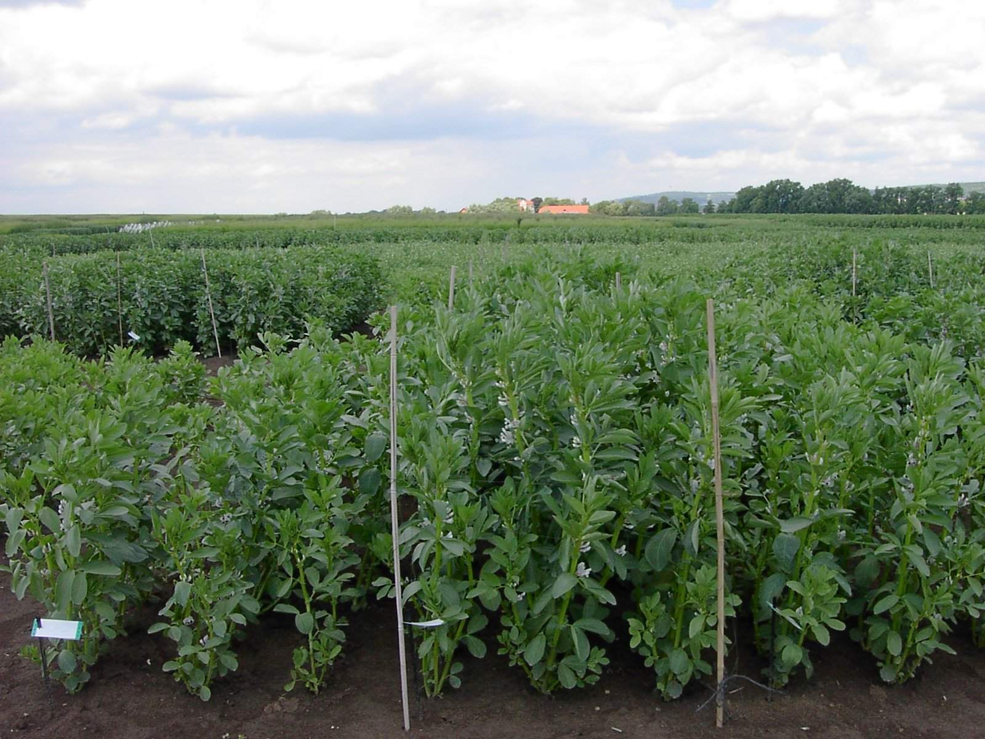
© Martsch
Enjoy a moment of recovery and recreation … before we continue.
12

Slide 13
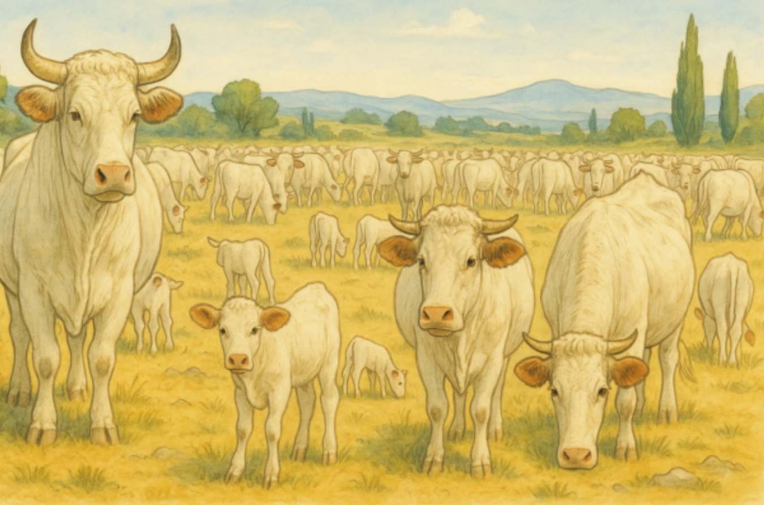

σ²_{A} = 2pq[a-(p-q)d]². σ²_{A} depends on p(A1) and q(A2); and on a & on d/a. Take d=a=1. Max. σ²_{A} then is 27/32 = 0.84375 at p=0.25, q=0.75. Beware, max. is not at p=0.5.
25.00
0.844
20.00
15.00
0.582
Amount of variance from 100 loci
Approximate HWE-populations
10.00
σ²_{A}
5.00
per locus
0.00
0.1
0.2
0.3
0.4
0.5
0.6
0.7
0.8
0.9
1.0
p(A1)
13

Slide 14
σ²_{A} = 2pq[a-(p-q)d]². σ²_{A} depends on p(A1) and q(A2). Take d=a=1 (ratio d/a=1).
Max. σ²_{A} then is 27/32 = 0.84375 at p=0.25, q=0.75 (there, α=α₁-α₂=1.5).
25.00
Imagine 100 loci that jointly control the genetic variation of the trait, all with p=0.25, and all with same impact on trait value: a=1 and d=1.
The population shall be in HWE. Can we then say that (at trait level)
σ²_{A(loci 1-100)} = 100 ∙ (2pq[a-(p-q)d]²) = 100 ∙ (2∙0.25∙0.75 ∙[1-(-0.5)∙1]²) ?
If ... LD=0 between all pairs of loci, hence, no correlation between the α₁ and α₂ of one and another locus … and if there is no epistasis … then yes, indeed.
0.84375
20.00
15.00
In this case, σ²_{A} = 84.375, hence, σ_{A} = 9.186. Consequently, we expect about 1/3 of genotypes to be (for Breeding Value) more than 9.186 trait units above the mean.
With p=0.10, for instance, σ²_{A} = 0.583 per locus. Smaller!
0.582
Amount of variance from 100 loci
10.00
σ²_{A}
Although it feels strange, the variance can be increased through selection: In case the frequency of allele A1 has not yet reached the p(A1) of maximum variance.
5.00
per locus
By the way: At p(A1)=0.25 and a=d=1 for the 100 loci, µ = -12.5, a negative value. Never mind, this is just Algebra.
The ‘worst’ genotype has as trait expression -100, the ‘best’ has 100.
0.00
0.1
0.2
0.3
0.4
0.5
0.6
0.7
0.8
0.9
1.0
p(A1)
14

Slide 15
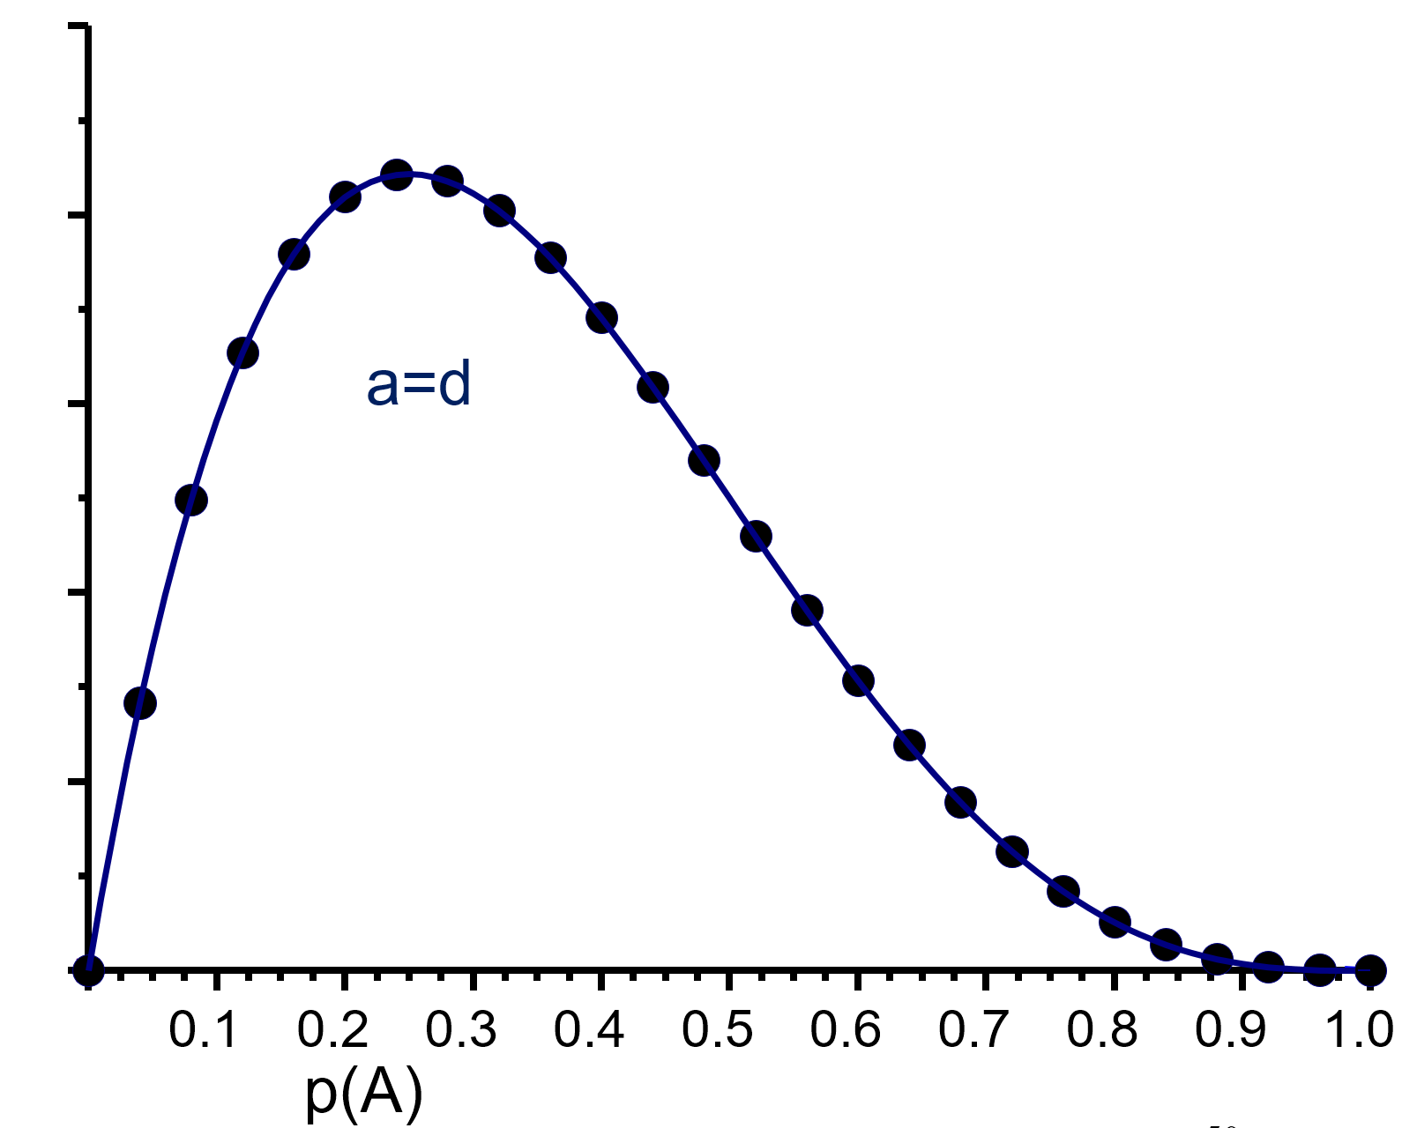
The additive variance at p=0.25 is larger (given a=d) than at p=0.10. At p=0.50, it is again smaller, σ²_{A} = 0.50 (and, just in case ;-) σ²_{A} = σ²_{BV} = var. of the Breeding Values)
0.844
Narrow or wide distributions of Breeding Values (a=d):
In case of …
p=0.10; p=0.25; p=0.5
0.583
To be super clear: The plot on the left side in-dicates - at each point on x-axis - a potential HWE population and normal distribution of its A values. Depending on where on x-axis we are, we have larger or smaller variance (y-axis) in that population. Three such ‘cases’ of a HWE population are highlighted.
σ²_{A} =2pq[a-(p-q)d]² per locus
0.500
These three curves were drawn with same mean ... which is not true but just to easier compare the breadth of the 3 curves.
p(A1)
Think of x-axis as showing increase of p(A1) through history of selection
15

Slide 16
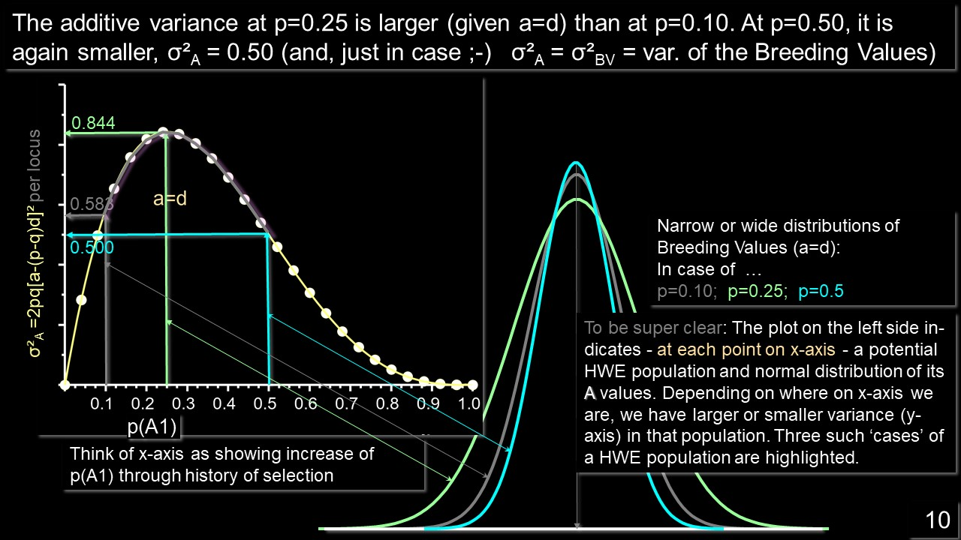
The mean values µ of these three populations, with p=0.1 or 0.25 or 0.5 are, of course different. The higher p is, the higher is µ.
With these 3 values, µ is either -62.0 or -12.5 or 50.0. The three curves hence differ for their means. They were – here - only shifted to the same value µ for visual ease.
16

Slide 17
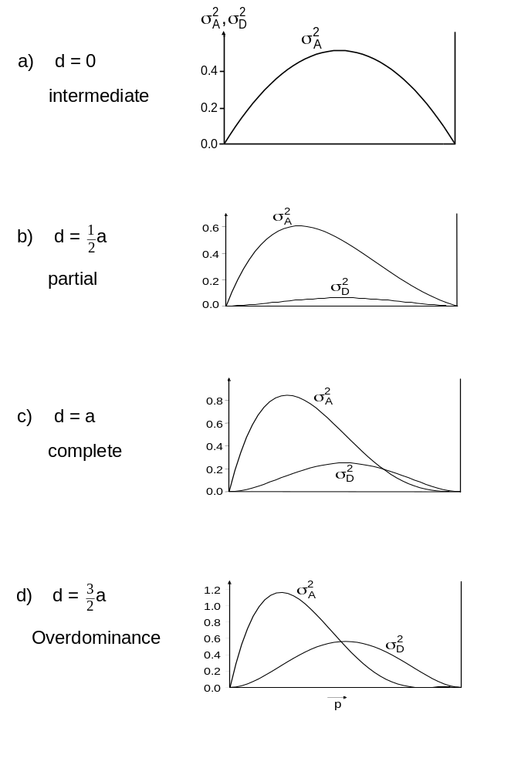

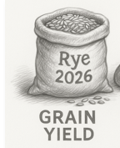
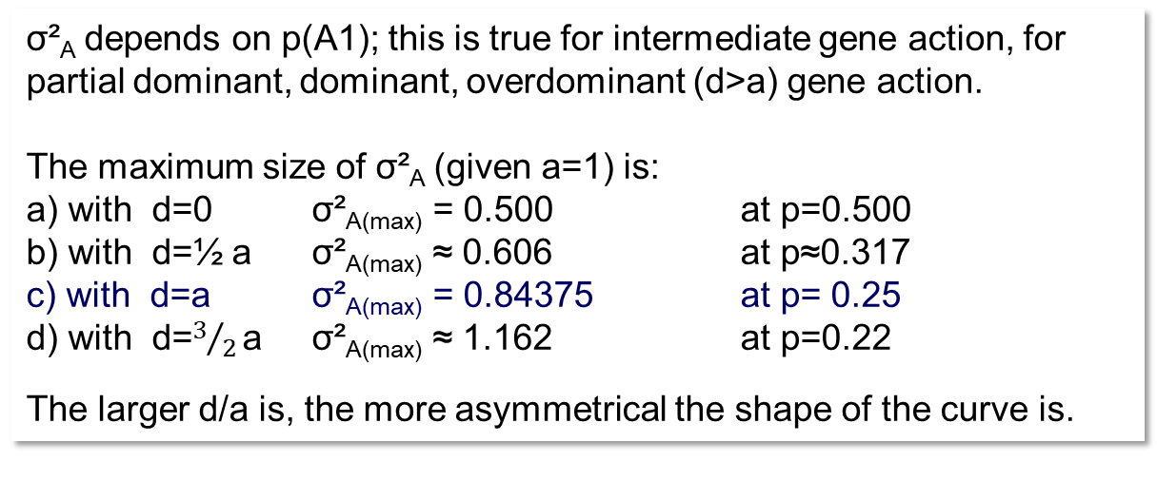
The diagrams tell the influence of the degree of dominance on size and development of the additive variance and dominance variance across the scale of p(A1) (0 < p < 1).
σ²_{A} depends on p(A1); this is true for intermediate gene action, for partial dominant, dominant, overdominant (d>a) gene action.
The maximum size of σ²_{A} (given a=1) is:
a) with d=0 σ²_{A(max)} = 0.500 at p=0.500
b) with d=½ a σ²_{A(max)} ≈ 0.606 at p≈0.317
c) with d=a σ²_{A(max)} = 0.84375 at p= 0.25
d) with d=$3/{2 }$a σ²_{A(max)} ≈ 1.162 at p=0.22
The larger d/a is, the more asymmetrical the shape of the curve is.
σ²_{A}
Dominance Variance σ²_{D} = (2pq d)².
σ²_{D} = The genetic contributions of the dominance deviations
δ₁₁ , δ₁₂ , δ₂₂ to the genetic variance.
It is symmetrical.
With e.g. d=4a (super-strong overdominance), σ²_{D} has even a higher maximum (at p=0.5) than σ²_{A} (at its then-p_{max} ≈ 0.176).
p
17

Slide 18
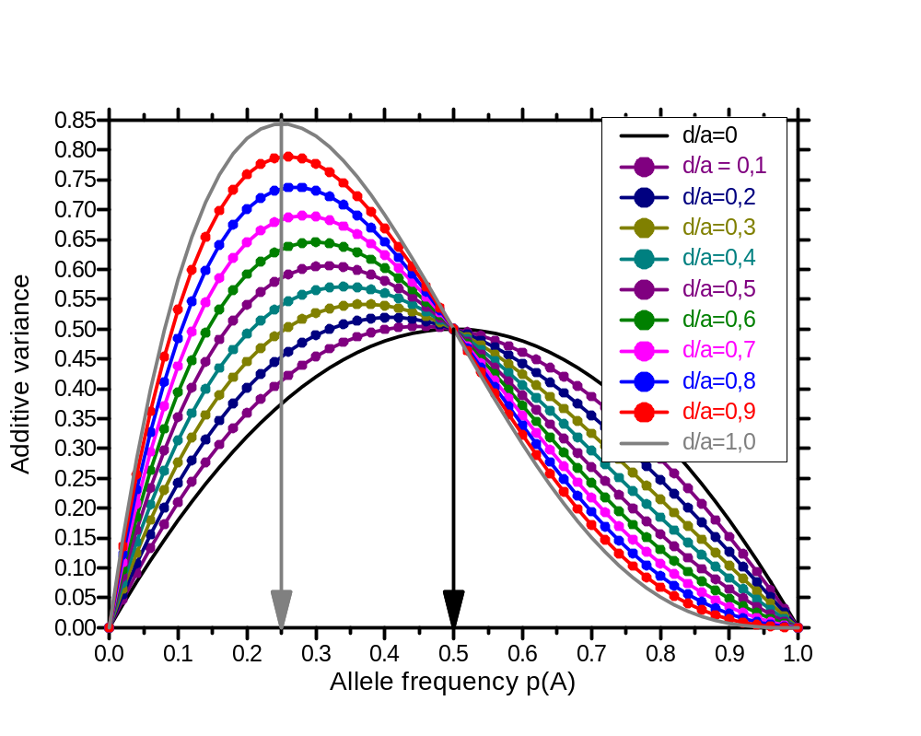
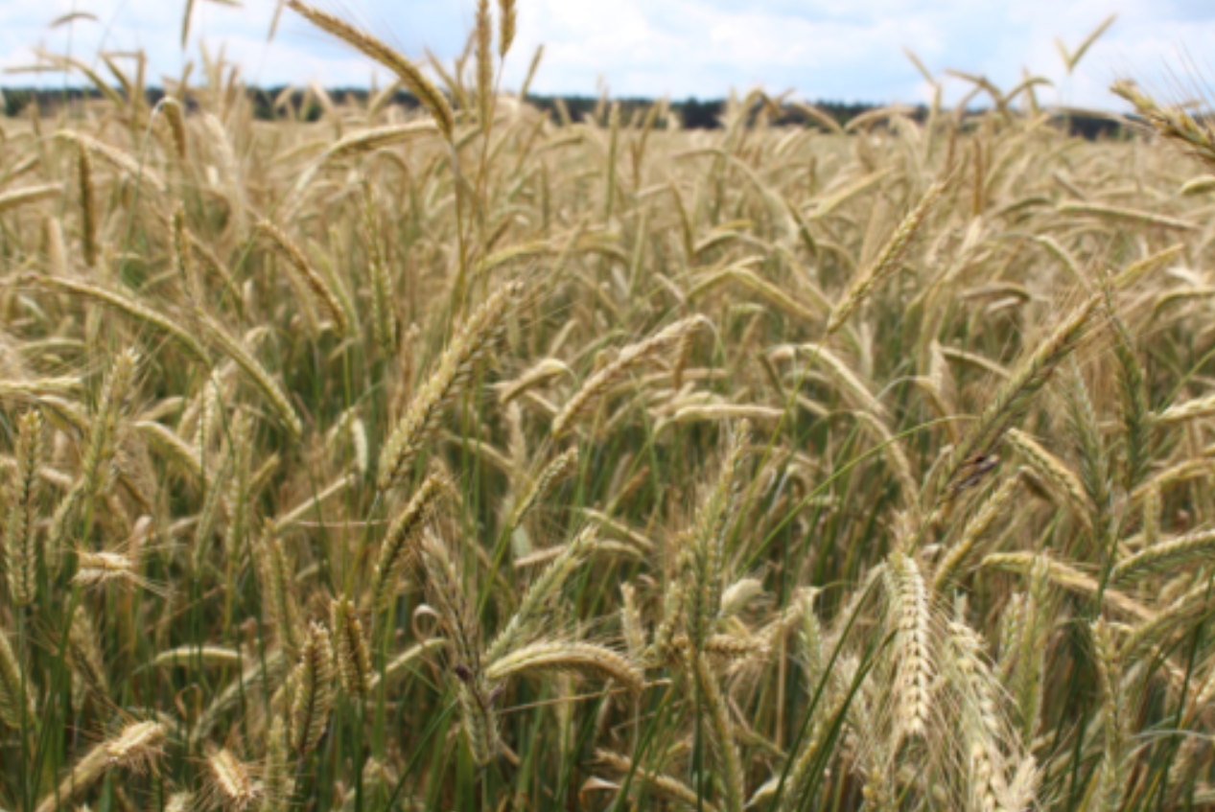
Just for beauty and fun: Additive Variance, p(A1), degree of dominance.
Gradual change of the shape of the Distribution of
„Amount of Additive Variance in a HWE population across the scale 0 < p(A1) < 1 of the frequency of allele A1“ …
… which is (see legend colours) changing as gene action gradually moves from
dominant (d/a) = 1.0 ► ... to
intermediate (d/a) = 0.0 ►.
Additive Variance
Allele frequency p(A1)
18
© A. Kristina Rada, 2016

Slide 19
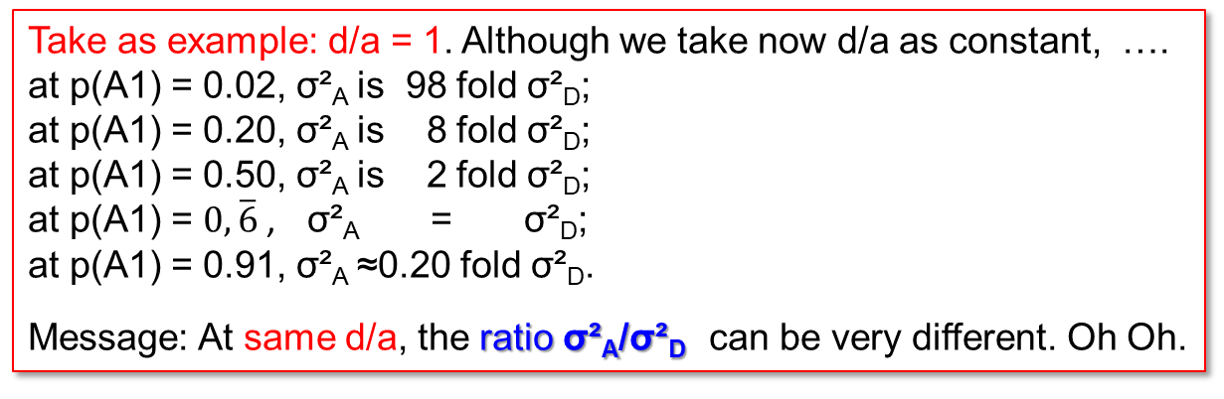
The diagrams tell the influence of the degree of dominance on size and development of the additive variance and dominance variance across the scale of p(A1) (0 < p < 1).
0
0.5
1
We compare here different levels of d/a. In case of d=0, for instance, we expect no heterosis (i.e. no inbreeding depression). This may be true for quality traits (e.g. baking quality). In case of d/a>0, on the contrary, we expect heterosis (e.g. grain yield).
For breeding, the correlation between current performance of selected candidates and their later performance in farmers‘ field is important; and if we use them for further breeding, then the correlation between them and their offspring is relevant => Variances, Covariances count.
σ²_{A}
d=a=1
complete dominance
Take as example: d/a = 1. Although we take now d/a as constant, ….
at p(A1) = 0.02, σ²_{A} is 98 fold σ²_{D};
at p(A1) = 0.20, σ²_{A} is 8 fold σ²_{D};
at p(A1) = 0.50, σ²_{A} is 2 fold σ²_{D};
at p(A1) = $0,\overline{6}$, σ²_{A} = σ²_{D};
at p(A1) = 0.91, σ²_{A} ≈0.20 fold σ²_{D}.
Message: At same d/a, the ratio σ²_{A}/σ²_{D} can be very different. Oh Oh.
p
19

Slide 20
For breeding, the correlation between current performance of selected candidates and their later performance in farmers‘ field is important*; and if we use them for further breeding, then the correlation between them and their offspring is relevant*. Therefore, Variances, Covariances are important Quantitative Genetic parameters, they are the components of such correlations.
You know: Correlation is the ratio between a covariance and the product of two standard deviations. You do not know the details? Well, go for it, help yourself (in a literal sense).
*this is the perspective of broad-sense h²
**this is the perspective of narrow-sense h²
20

Slide 21
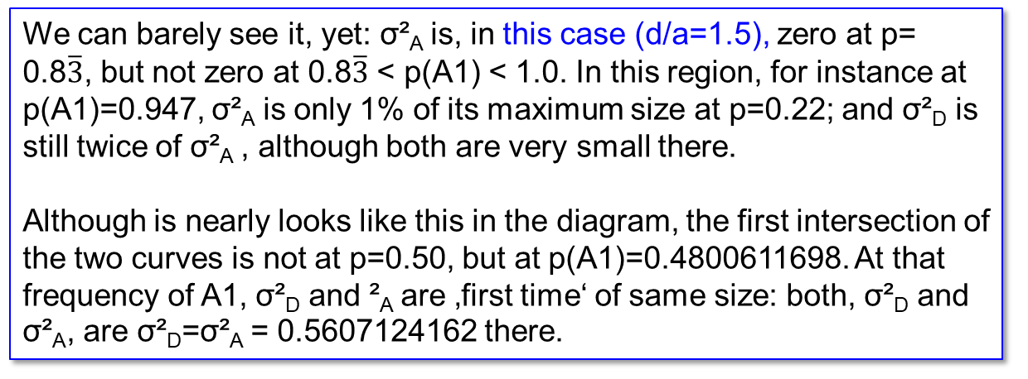
The diagrams tell the influence of the degree of dominance on size and development of the additive variance and dominance variance across the scale of p(A1) (0 < p < 1).
Not all details are of same importance, some details are rather for enthusiasts.
0
0.5
1
True over-dominance is rather rare. Typical degree of dominance are
0 < d/a < 1. DOI 10.1016/j.tig.2023.12.003; DOI 10.1111/evo.14189;
DOI 10.2134/1999.geneticsandexploitation.c5
σ²_{A}
We can barely see it, yet: σ²_{A} is, in this case (d/a=1.5), zero at p= 0.8$\overline{3}$, but not zero at 0.8$\overline{3}$ < p(A1) < 1.0. In this region, for instance at p(A1)=0.947, σ²_{A} is only 1% of its maximum size at p=0.22; and σ²_{D} is still twice of σ²_{A} , although both are very small there.
Although is nearly looks like this in the diagram, the first intersection of the two curves is not at p=0.50, but at p(A1)=0.4800611698. At that frequency of A1, σ²_{D} and ²_{A} are ‚first time‘ of same size: both, σ²_{D} and σ²_{A}, are σ²_{D}=σ²_{A} = 0.5607124162 there.
d=1.5a
over- dominance
p
21

Slide 22
Les us exploit an opportunity to think outside the box, across different areas of ‘Applied Genetics’.
Join ‘Natural Selection’
(which is a topic from Population Genetics)
...
with ‘Genetic Variance in case of Overdominance’
(which is a topic from Quantitative Genetics).
22

Slide 23
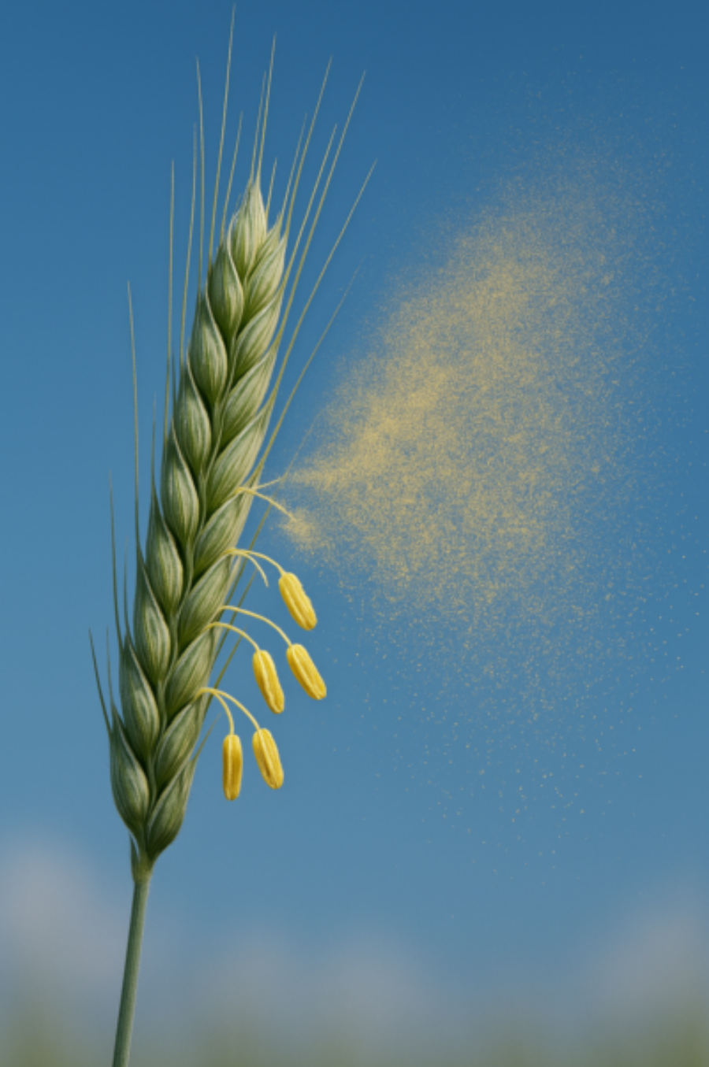
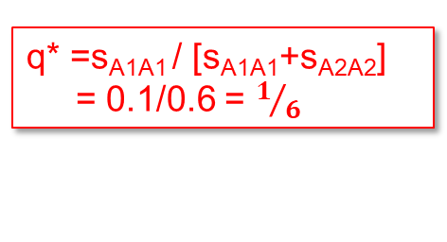
You have seen this in UNPLAB-PopGen_Ch-6[Selection], pages 25 and 26 ;-)
Initial frequency q(A2) = 0.999
1.0
Random mating, s_{A2A2}=0.1, s_{A2A2}=0.5
++
0.9
In case start was at q(a)< 1/6, then q* would be the same
0.8
0.7
Whatever the start value is,
q* is always the same
0.6
Frequency of unfavourable allele ‘A2'
0.5
q* =s_{A1A1} / [s_{A1A1}+s_{A2A2}]
= 0.1/0.6 = $1/6$
0.4
0.3
0.2
0.1
0.0
0
5
10
15
20
25
30
35
40
45
50
Cereal shedding pollen to vi-sualize ‚pollen cloud‘ and out-crossing as proxy of Random Mating.
Generations under constant selection against ‘A2'
23

Slide 24
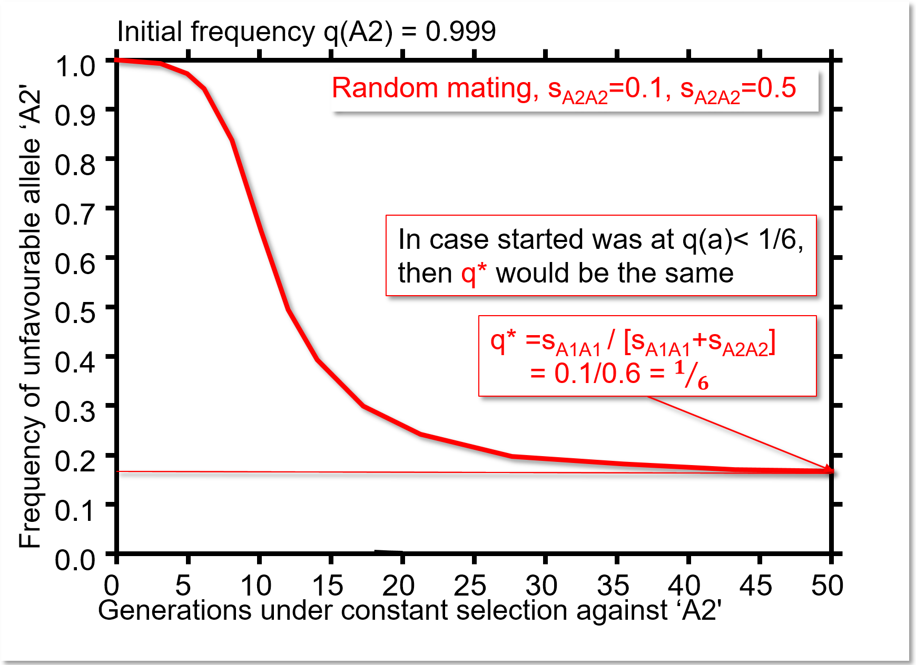
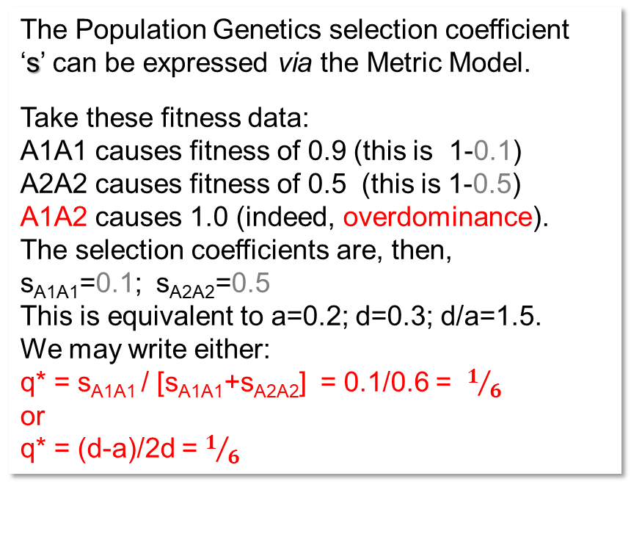
Rehearsal ‚Natural Selection‘. Random Mating and Natural Selection against unfavourable allele A2. Here we look at the case of overdominant gene action.
The Population Genetics selection coefficient
‘s’ can be expressed via the Metric Model.
Take these fitness data:
A1A1 causes fitness of 0.9 (this is 1-0.1)
A2A2 causes fitness of 0.5 (this is 1-0.5)
A1A2 causes 1.0 (indeed, overdominance).
The selection coefficients are, then,
s_{A1A1}=0.1; s_{A2A2}=0.5
This is equivalent to a=0.2; d=0.3; d/a=1.5.
We may write either:
q* = s_{A1A1} / [s_{A1A1}+s_{A2A2}] = 0.1/0.6 = $1/6$
or
q* = (d-a)/2d = $1/6$
Of course, if we start with frequency 0 > q(A2) < 1/6 (meaning lower than q*), then q(A2) strives towards the same equilibrium* frequency q*(A2) = 1-p*(A1).
24

Slide 25
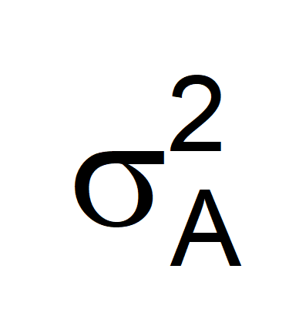
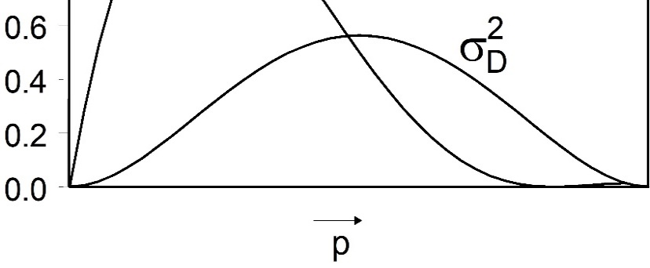
Overdominance; population mean and genetic variance as function of p(A1)
25
At q(A2)=q*: Zero Additive Variance and, by the way, the population is at its maximum µ (maximum mean performance of population).
The only option to arrive at higher performance would be to select (to isolate) the best i.e. he-terozygous genotype(s) and use it without al-lowing further meiosis. This is directly possible via clone breeding and indirectly with hybrid breeding. This means to abandon Population Breeding, it would mean (at q*) to exploit σ²_{D} as the only remaining source of genetic vari-ance. It might be helpful to think of this as a polygenic rather than as monogenic setting, since this makes clear: The target genotype would be heterozygous at all such-loci of trait.
Although additive variance is not zero between q* and q=0, its size is negligible: As q decree-ses from q* to q=0, genotypic variance steadily decreases in parallel to the decrease of σ²_{D}.
Overdominance is one explanation for maintaining more than one allele in spite of long-lasting selection. With overdominance,
q* ≠ 0. Further reading: Pseudo-overdominance, marginal over-dominance, estimation of degree of dominance.
DOI 10.1038/nature19760; DOI 10.1098/rspb.2023.2816
DOI 10.1007/s00122-023-04436-5
DOI: 10.1371/journal.pgen.1000008

Slide 26
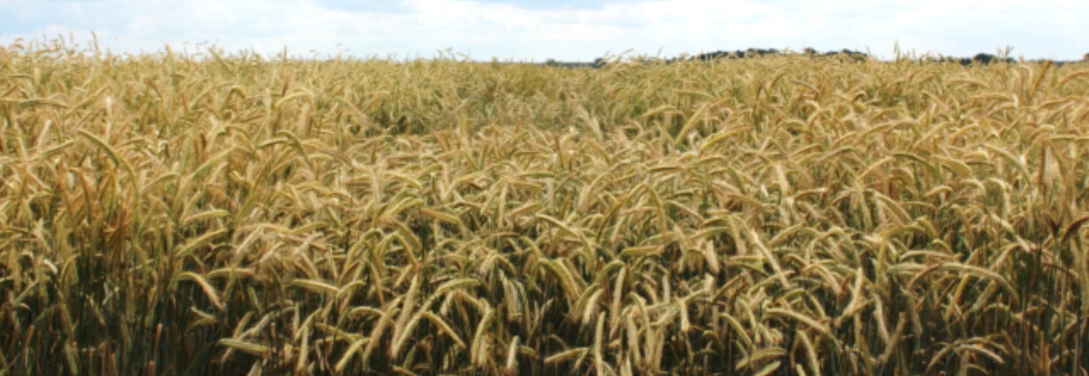
We leave overdominance and go back to a more ‘usual’ case:
humble yet full dominance, d=a
© A. Kristina Rada, 2016
26

Slide 27
Total genetic variance σ²_{G} is the sum of σ²_{A} and σ²_{D}: σ²_{G} = σ²_{A} + σ²_{D} (HWE, of course).
σ²_{G} = σ²_{A} + σ²_{D}
a=d=1
With p≈0.634, we find, interestingly,
σ²_{G} to be of size σ²_{G}=0.46410 ...
...
regardless of whether we have
either (1) a = d = 1
or (2) a = 1, d=0.
Same genotypic variance at that specific allele frequency with contrasting types of gene actions!
σ²_{A}
a=d=1
Size of variance in HWE conditions
0.5
σ²_{A}=σ²_{G}
a=1; d=0
© A. Kristina Rada, 2016
σ²_{D}; d=1
0.0
0.1
0.2
0.3
0.4
0.5
0.6
0.7
0.8
0.9
1.0
p(A1); a=d=1
0.633975
This diagram is meant to show that indeed, it matters whether σ²_{G} > σ²_{A} (means, whether σ²_{D} > 0).
27

Slide 28
Total genetic variance σ²_{G} is the sum of σ²_{A} and σ²_{D}: σ²_{G} = σ²_{A} + σ²_{D} (HWE, of course).
σ²_{G} = σ²_{A} + σ²_{D}
a=d=1
Take a=d=1, i.e. a/d=1; and take p=0.10:
σ²_{A} = 0.5832 and σ²_{D} = 0.0324.
Consequently, there, at p=0.10, we find
σ²_{G} = 0.5832 + 0.0324 = 0.6156.
σ²_{A}
a=d=1
0.6156
With p≈0.634, we find, interestingly, σ²_{G}
to be of size σ²_{G}=0.46410 ...
...
regardless of whether we have
either (1) a = d = 1
or (2) a = 1, d=0.
Same genotypic variance at that specific allele frequency with two very different gene actions!
Size of variance in HWE conditions
0.5
σ²_{A}=σ²_{G}
a=1; d=0
If we selected the best individuals in this case and checked the superiority of their offspring (from random mating), we would find that, al-though we exploit the same genetic variance, the gain in the case of d=0 higher than in the case of d=1 (more Algebra later).
σ²_{D}; d=1
0.0
0.1
0.2
0.3
0.4
0.5
0.6
0.7
0.8
0.9
1.0
p(A1); a=d=1
0.633975
This thought experiment shows that indeed, it matters whether σ²_{G} > σ²_{A} (means, whether σ²_{D} > 0).
28

Slide 29

We have four categories of Plant Breeding: Line Breeding, Clone Breeding, Population Breeding, Hybrid Breeding. Which ‘type’ of genetic variance ... where?
Again: Which ‚part‘ of the genetic diversity is exploited in which of the four Methodological
Breeding Categories (cf. UNPLAB-BrMeth_Ch-1[Intro]) ?
■ Line Breeding. Selection between homozygous-homogeneous inbred lines.
Line cultivars are homozygous, no dominance effect d is realized. In Line Breeding,
σ²_{A} is exploited. Yet. σ²_{G} = σ²_{Add.} as realized at homozygosity of the breeding germplasm
is different from the σ²_{A} which is a share of σ²_{G} at HWE status of the germplasm. The statisti-
cal additive effects are defined with respect to HWE, not versus a homozygous diversity.
At homozygosity, σ²_{G} = 2σ²_{A} + 4 D₁ + D₂* (Cockerham & Weir, 1984; Lynch & Walsh, 1998).
Deviating from HWE creates covariances between our statistical additive effects and our statis-
tical dominance deviations. Algebra is more complicated then. Remember: Even homozygous
genotypes are modelled ‘with’ dominance deviations (δ₁₁;δ₂₂). Epistatic interactions between
homozygous loci should be considered, too.
■ Clone Breeding or ■ Hybrid Breeding. Selecting between non-inbred, homogeneous genotypes (clones, SC hybrids). Clone and Hybrid cultivars are typically non-inbred. In Clone and Hybrid Breeding, σ²_{G} = σ²_{A} + σ²_{D} is exploited. Epistatic interactions between homozygous and heterozygous loci may be considered.
■ Population breeding. σ²_{A} is exploited, just as it is defined vs. the non-inbred reference population.
σ²_{D} can not be exploited.
Favourable SCA-effects and favourable epistasis can barely be exploited since the cvs. are not homogeneous. Instead, some quantity of variation due to the genetic heterogeneity (competition, faciliation ... ) may occur.
29

Slide 30
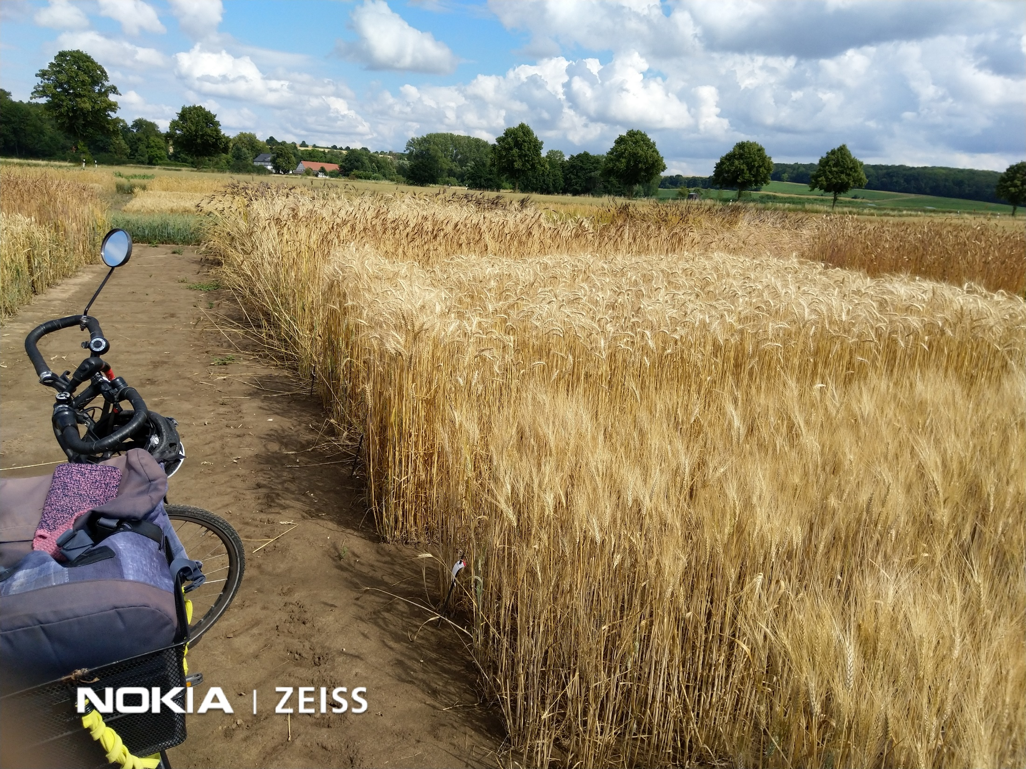
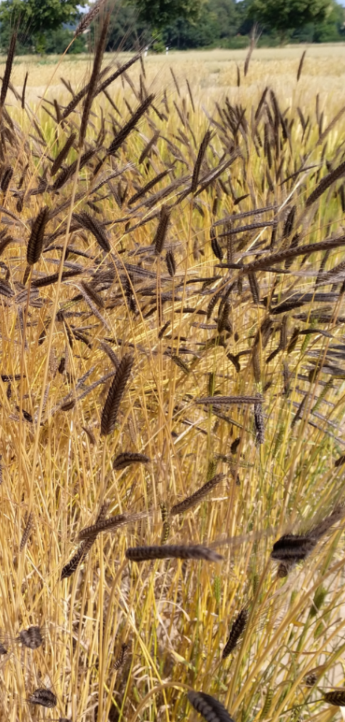
A page for relaxation
© WL
30

Slide 31
Impact of p(A1) on absolute and relative size of additive and dominance variance and one or two consequences for you.
Selection ‚for‘ A1 will increase its frequency and change a-mount and composition of the genetic variance that is contri-buted by this locus to this trait. When conducting Population Breeding (for instance via Recurrent Selection for GCA), σ²_{A} is exploited. As long as we increase the frequency of dominant, favourable alleles from p(A1)≈0 across p(A1)=10% to p(A1)=25%, we simultaneously increase σ²_{A}. Gain from selection will increase and we suffer very little from not-exploiting σ²_{D}.
Eventually we may reach allele frequencies such as p=80%. Most of σ²_{A} is spent, and, relatively, σ²_{D}, looks interesting. ‚Better exploit it now‘. This becomes an option if we switched from Population Breeding to Hybrid Breeding. In many crops, sunflower, corn, rye, sugar beet, earlier or later breeders switched to Hybrid Breeding. One reason is visible here.
σ²_{G} = σ²_{A} + σ²_{D}
a=d=1
σ²_{A}
Size of variance in HWE conditions
σ²_{D}
And: Rather breed a ‘young’ germplasm! Gene-tic Variance and hence gain promise to be more (faster, easier) than in an advanced germplasm.
0.0
0.1
0.2
0.3
0.4
0.5
0.6
0.7
0.8
0.9
1.0
p(A1); a=d=1
31

Slide 32
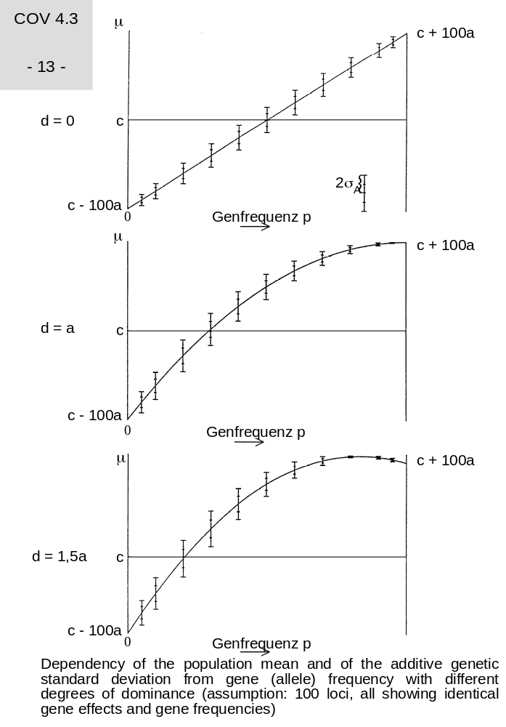
One of my favourite because amazing, instructive, awesome ;-) diagrams in Quantitative Genetics. Even though it is only based on our Genetic Model.
*yes, I am using a small number of ideas again and again ...
µ
c+100a
Dependency of the population mean and of the additive genetic standard deviation on the allele frequency, shown with different degrees of dominance (d/a). Assume 100 loci, all with identical allele effects (a=1) and in each situation all with identical allele frequency. If the population is for instance at p(A1)=0.25 for one locus, then the ‘number-1 allele’ of all further 99 loci shows 25% frequeny, too*). Anyway: HWE, no Epistasis, LD=0.
© HHG & FG, Hohenheim.
We saw earlier that with d=0, µ of the population increases linearly with p(A1). The short vertical bars indicate the variance (not σ² but σ) of the Breeding Values, which is maximum at p=q (and zero at p=0 and p=1).
With d<0, maximum of additive variance is not at p=q but at the zone of p<q, as we saw earlier. You remember, with d=a, σ²_{A} is maximum at p(A₁)=0.25
We saw that with d>a, µ of the population is maximum at p<1.0. Indeed, if the heterozygotes perform ‚better‘ than either homozygotes (d>a), then maximum cannot be at p=1, because there, heterozygosity is impossible.
d=0
c-100a
d=a
p(A1)=0
p(A1)=1
Allele frequency p(A1)
32

Slide 33
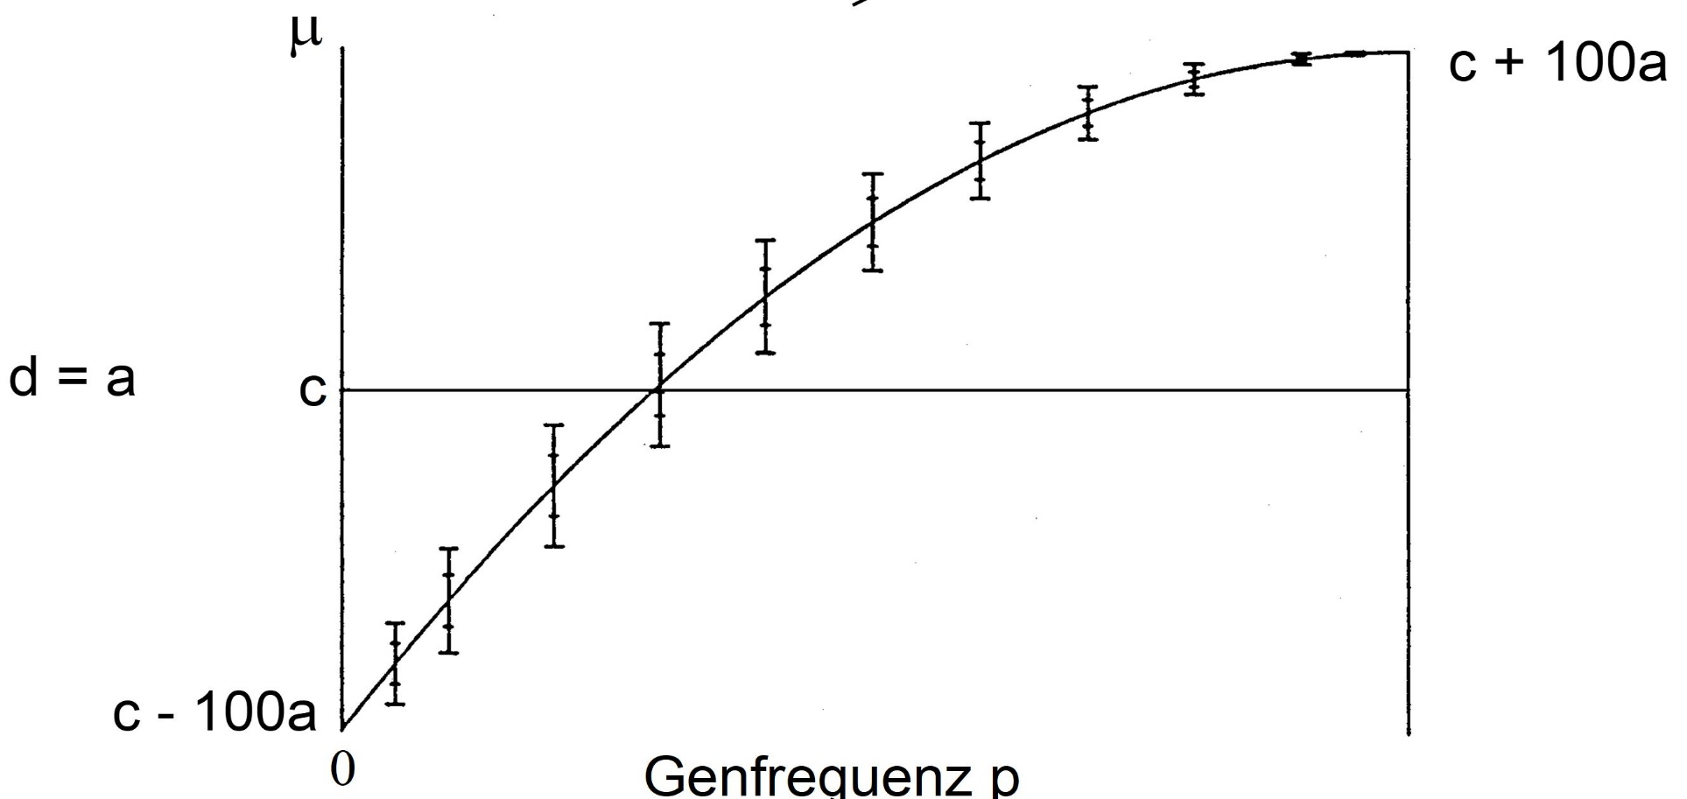
One of my favourite diagrams.
Allele frequency p(A1)
Dependency of the population mean and of the additive genetic Standard Deviation on the allele frequency, zoomed in for d=a. Assume 100 loci, all with identical allele effects (a=1) and in each situation all with identical allele frequency. Anyway: HWE, no Epistasis, LD=0.
33

Slide 34
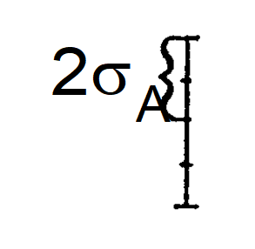
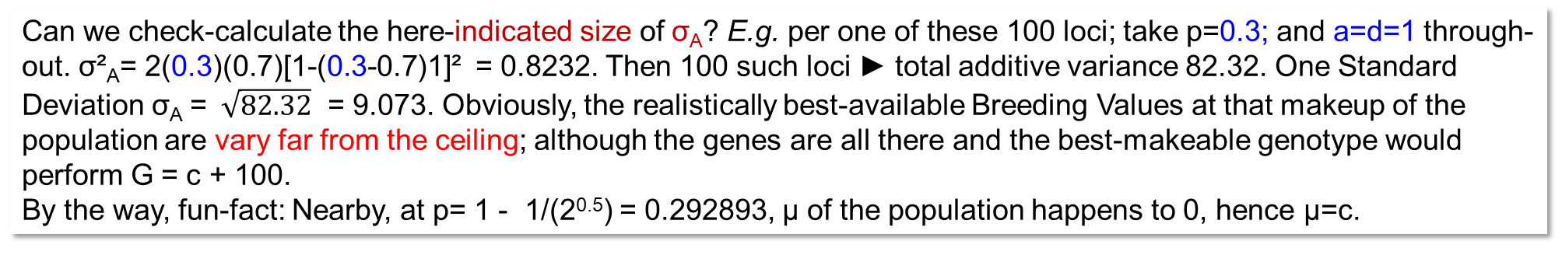
One of my favourite ... (1920 etc. pretends we see the history of breeding progress )
Even a p(A1) << 1 (same at each of the 100 loci), the population has genes (alleles) that allow a perfor-mance of
µ+A = c+a₁+a₂+a₃+ … a₁₀₀ = c+100a
(at p(A1)=1 for all loci, σ²_{G} is zero, Breeding Value is meaningless).
The ‘good’ alleles would simply all have to be assembled in the same genotype. But: Such genotype can not be found.
Why?
… too rare!
Drama
1920
1970
2020
Best genotype that,
in this situation, can realistically be found
in the population
0.3
1
Allele frequency p(A1)
Can we check-calculate the here-indicated size of σ_{A}? E.g. per one of these 100 loci; take p=0.3; and a=d=1 through-out. σ²_{A}= 2(0.3)(0.7)[1-(0.3-0.7)1]² = 0.8232. Then 100 such loci ► total additive variance 82.32. One Standard Deviation σ_{A} = $\sqrt{82.32}$ = 9.073. Obviously, the realistically best-available Breeding Values at that makeup of the population are vary far from the ceiling; although the genes are all there and the best-makeable genotype would perform G = c + 100.
By the way, fun-fact: Nearby, at p= 1 - 1/(2^{0.5}) = 0.292893, µ of the population happens to 0, hence µ=c.
34

Slide 35
One of my favourite ...
Even a p(A1) << 1 (same at each of the 100 loci), the population has genes that allow a performance of
G=c+a₁+a₂+a₃+ … a₁₀₀ = c+100a.
Too rare! Why?
Because they need to belong to the either 2pq or p² fraction, and at e.g. p=0.3, this means 0.3²+2*0.21=0.51 per locus. Hence (zero LD): Prob. to get an individual that belongs to this 51% fraction at each of 100 loci is 0.51¹⁰⁰ = 5.7 ∙10⁻³⁰. They just do not occur, even in many millions of plants.
1920
2020
1970
Allele frequency p(A1)
What a Drama! The genes are there, really there, if they were gathered to-gether in one genotype, then they would cause incredibly high yields, without more fertiliser etc.; it just takes a very long time of classical breeding before we first see these types. The best varieties today would indeed have seemed like products of magic to our ancestors 100 years ago.
Yet, again: This is a model of genetics, not the biologically true genetics.
35

Slide 36
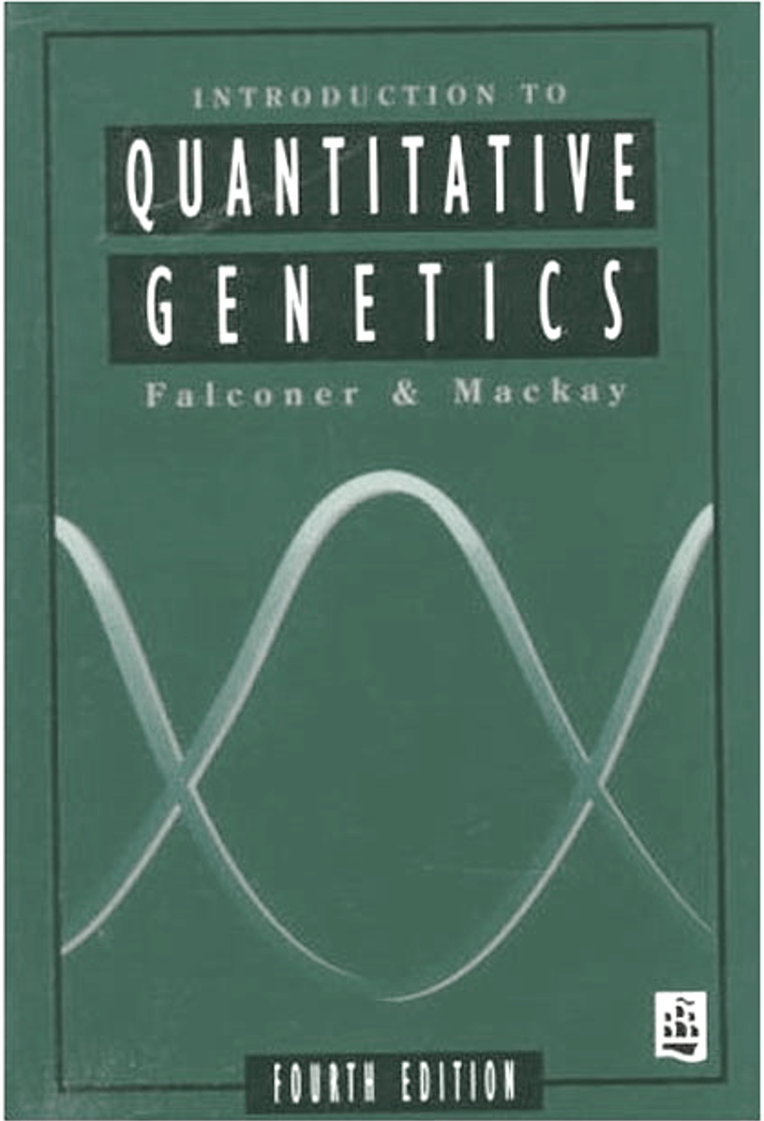
36
One of my favourite ...
1920
2020
1970
Allele frequency p(A1)
Did you sense our jump from perspective ‚HWE of one locus, looking on many individuals‘ to ‚HWE of one individual, looking on many loci‘? Jump works if all loci show same allele frequency (as we oftentimes assume here).
Either:
We have – say – 100 individuals and one locus. With e.g. p=0.3, we expect P=p²=9 of them as A₁A₁, H=2pq=42 of them as A₁A₂, and Q=q²=49 as A₂A₂.
Or:
We have one individual and 100 loci all with p=0.3; we expect 9 of the 100 loci with genotype X₁X₁, 42 with X₁X₂, and 49 with X₂X₂ (X stands for any one of the 100 loci; LD=0, throughout, otherwise it won‘t work).

Slide 37
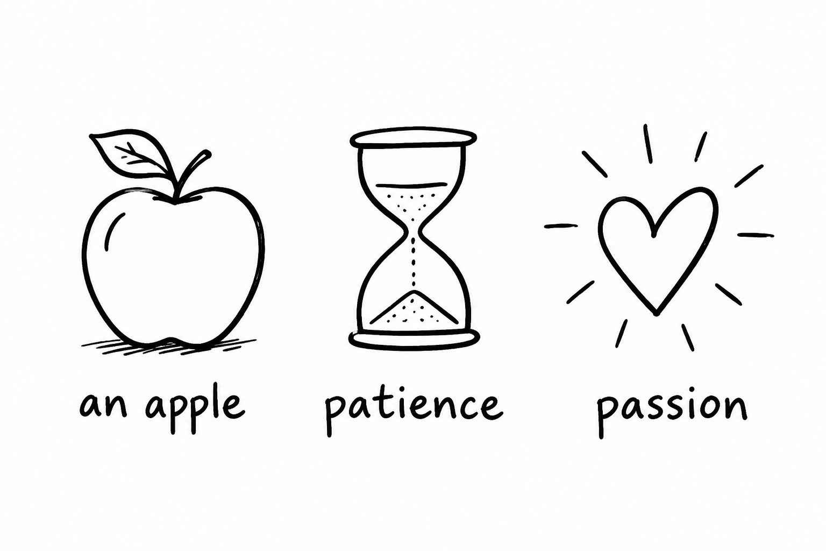
From here you may go to UNPLAB-QuGen_Ch-10[GenV 0>F>1]
For that one, take yourself an apple, patience, and passion.
37

